Slide 1
Behavioural Models: From Modelling Finite Automata to Analysing Business Processes First Edition Figures of Chapter 2
Matthias Kunze, Mathias Weske

Slide 2
Legal Notice
This file contains figures used in the textbook: Matthias Kunze, Mathias Weske: Behavioural Models: From Modelling Finite Automata to Analysing Business Processes. ISBN 978-3-319-44958-6. Springer International Publishing Switzerland 2016
Each slide contains one picture in PNG-format with caption and copyright notice. It is illegal to remove the copyright notice from any of the figures.
Commercial use in any form is not allowed without prior written approval by Springer-Verlag
Matthias Kunze, Mathias Weske

Slide 3
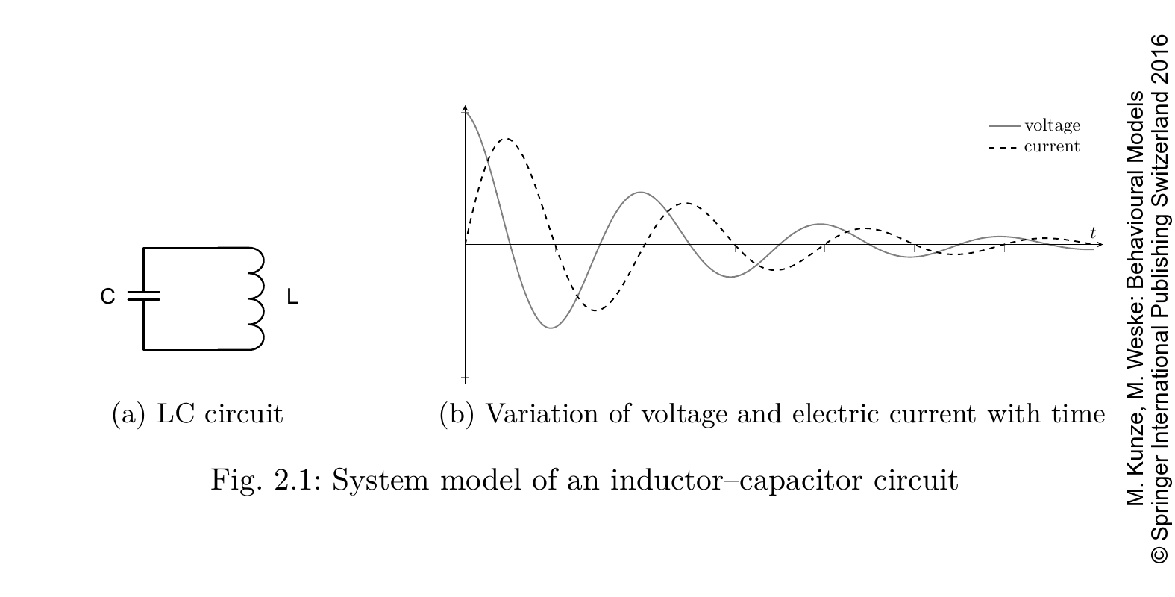

Slide 4
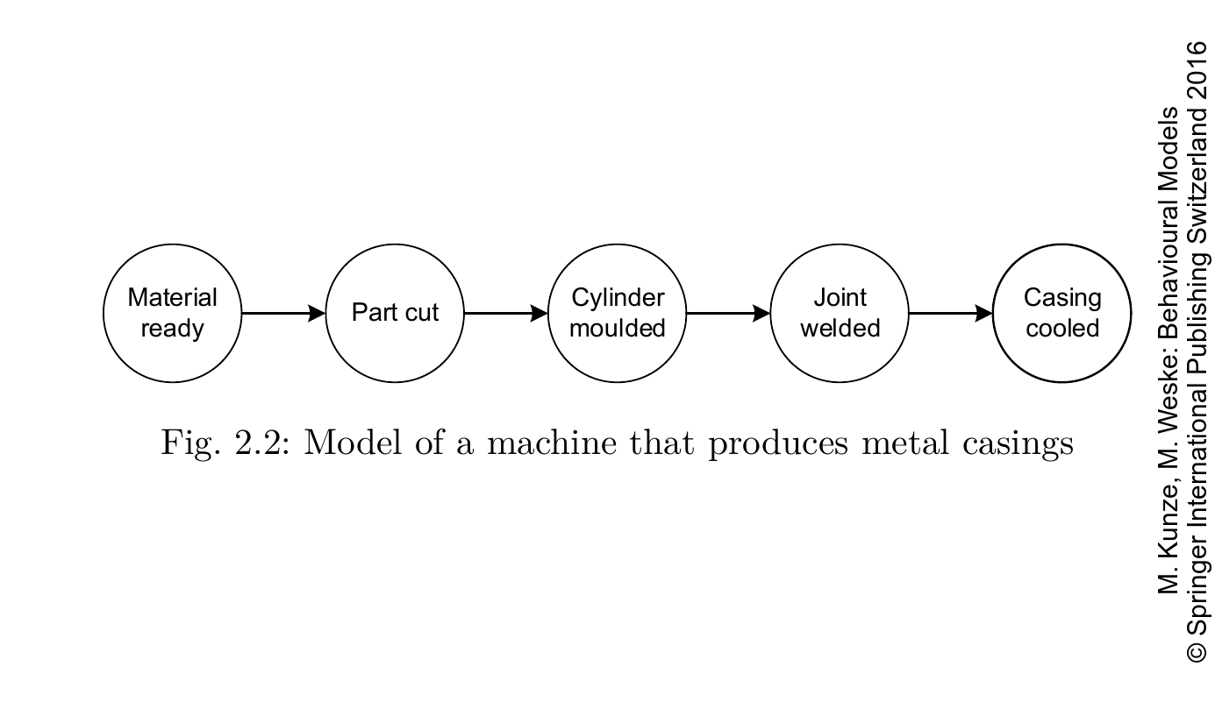

Slide 5
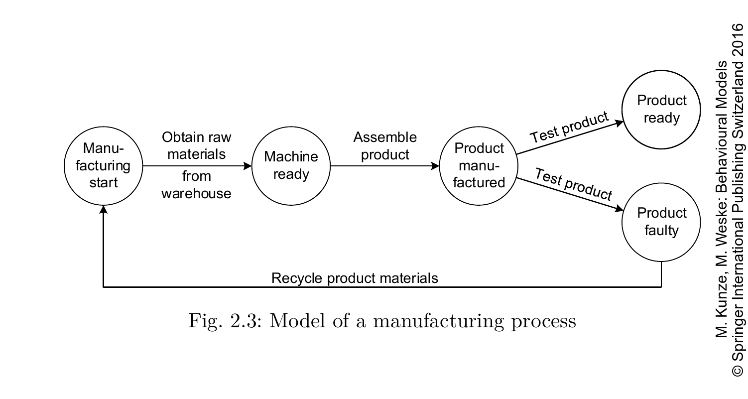

Slide 6
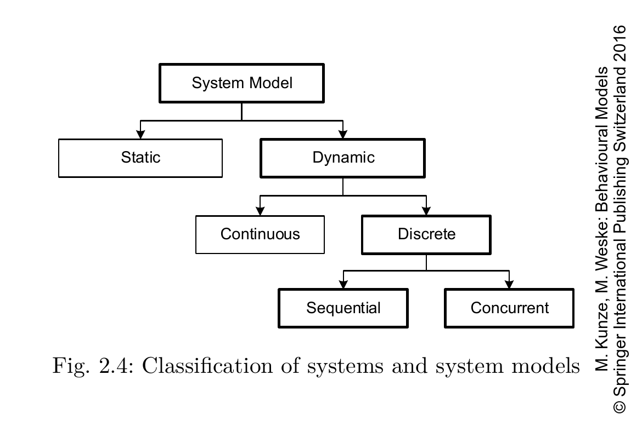

Slide 7
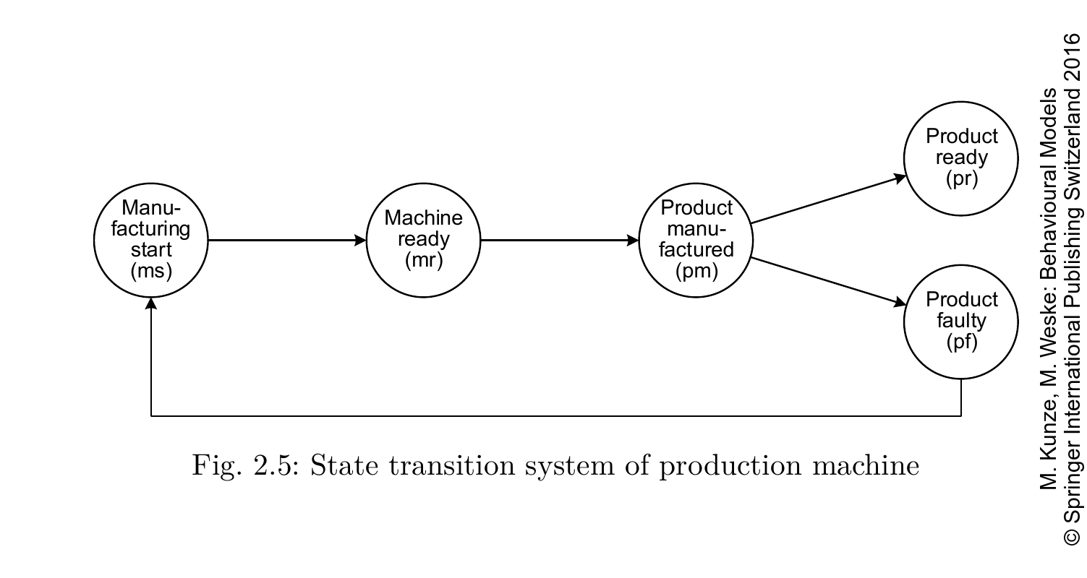

Slide 8
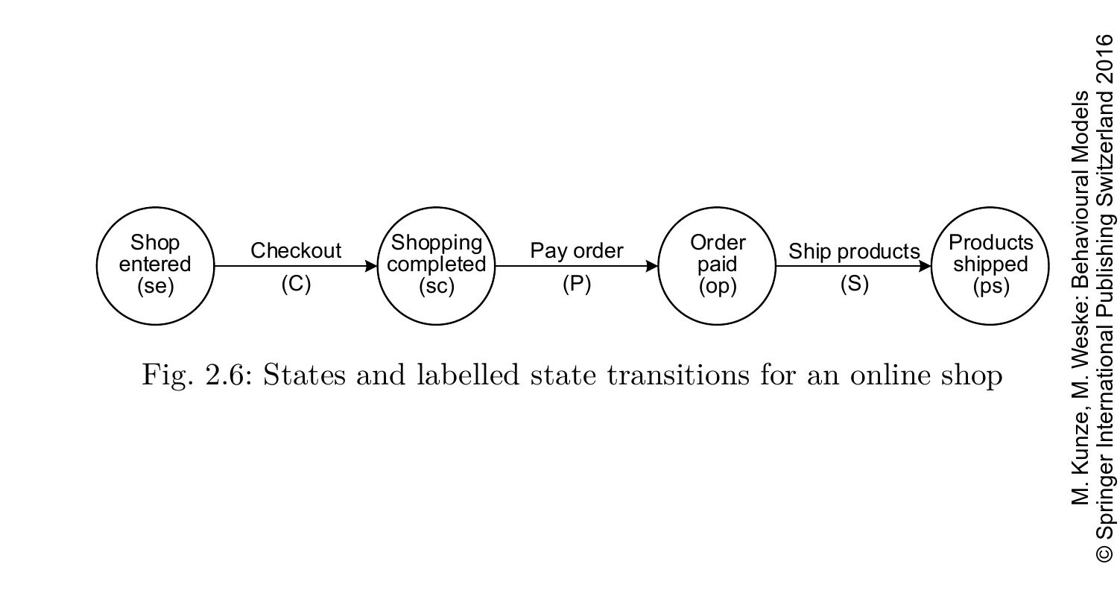

Slide 9
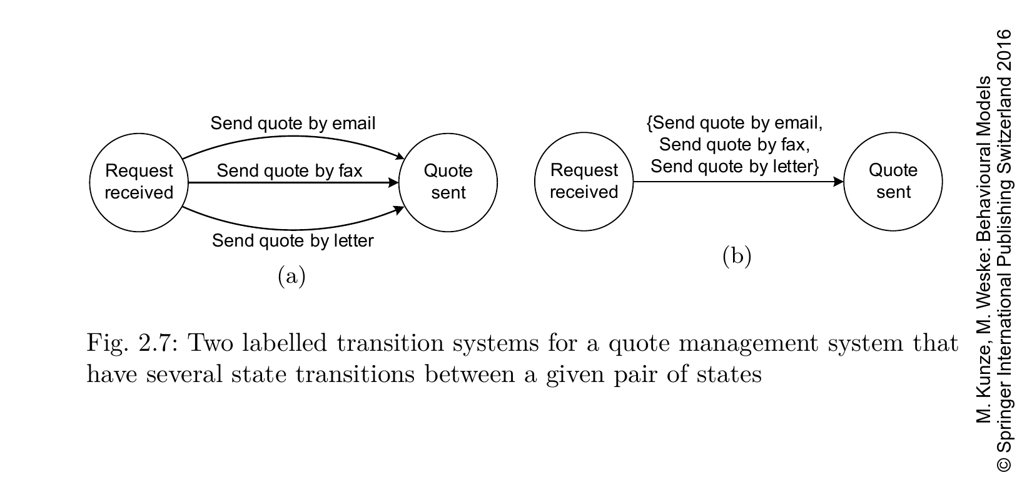

Slide 10
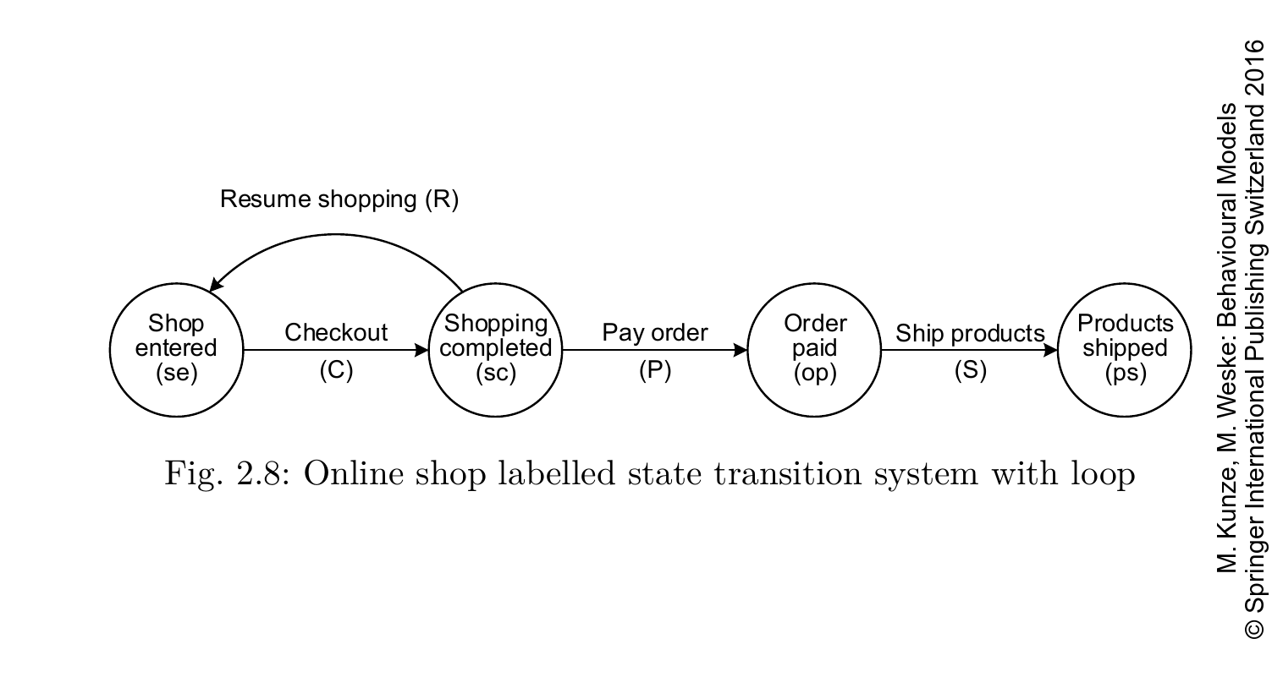

Slide 11
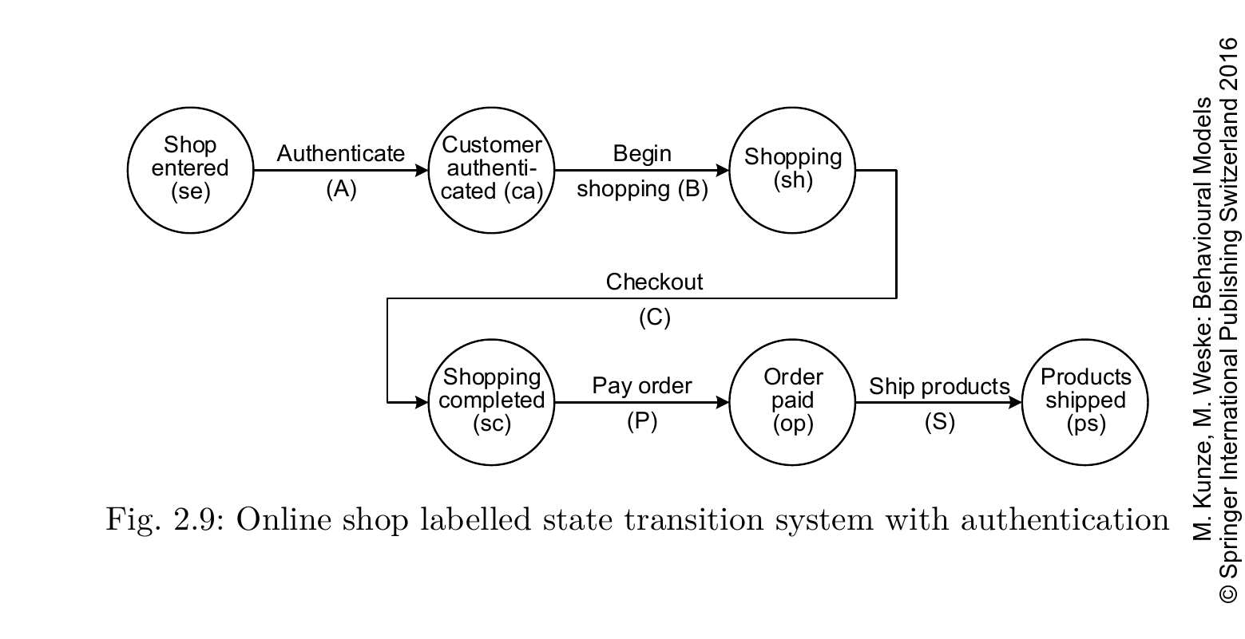

Slide 12
